Slide 1
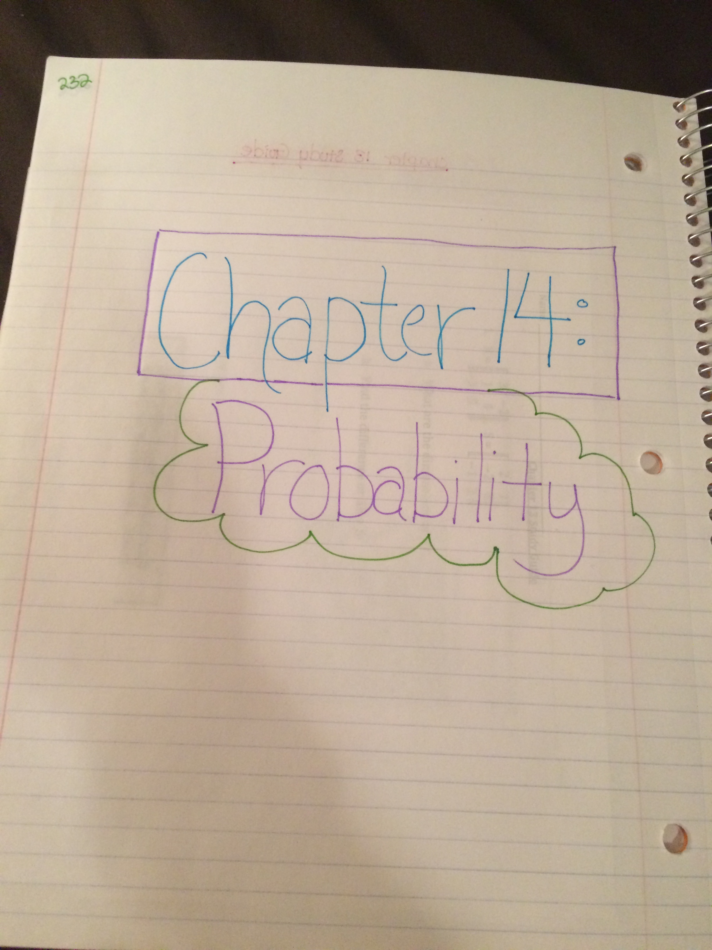
Make title page (p. 232) & TOC
Chapter 14 - Probablility
232. Chapter 14 Title Page
233. Chapter 14 Vocabulary
234-35. Warmups
236-37. 14.1 - Counting Outcomes
238-39. 14.2 - Permutations & Combinations
240-41. 14. 3 - Probability of Compound Events
242-43. 14.4 -Probability Distributions
244. Chapter 14 Quiz
245. Chapter 14 Study Guide

Slide 2
14.1 – Counting Outcomes p. 236-237
5/10/16
SWBAT: count outcomes using tree diagrams & the counting principal

Slide 3
Factorials:
8!
10!

Slide 4
The deli offers a special where you can choose a sandwich, side & beverage. If there are 10 different sandwiches, 12 sides, & 7 beverages, how many different lunch specials can be ordered?

Slide 5
Number 10 on homework
Buying a computer with a choice of CD-Rom, CD recorder, or DVD drive, one of 2 monitors, and either printer or scanner.

Slide 6
Homework:
14.1
9-17 ALL & Vocabulary (p. 233)

